Slide 1
Software Engineering and Architecture
Broker I Mandatory:
First Steps on Distributed HotStone

Slide 2
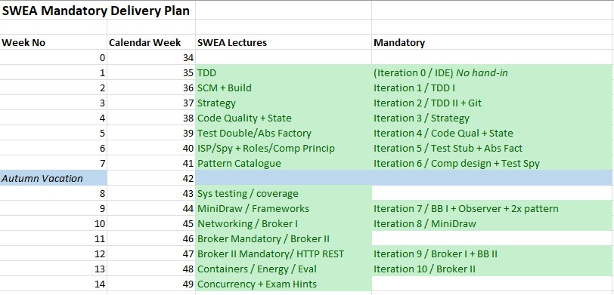
Don’t Panic
I will introduce the Broker I mandatory
… but it is not this week’s hand-in ☺

Slide 3
Some Experiences
HotStone is not difficult to ‘go distributed’, but ..
  It was not designed with distribution in mind
    But the ‘Facade’ pattern nature of Game is actually ideal
  It contains an Observer pattern, however!
    Which our Broker does specifically not support !
  There are a lot of methods
    Means a lot of ‘if (operationName.equals(xxx))’
  It is multi-class and multi-object
    Game, Card, Hero, Player, …
  It is a non-trivial code base
    Abstract Factory, Xstrategy, ...

Slide 4
Double Leap
Making HotStone distributed is not hard...
  ... Once you know the details in Broker
    I solved the ‘hard parts’ in a couple of hours coding time
    Disclaimer – I probably know Broker pretty well by now after having written the book and fumbled my way through it for a couple of years in a couple of projects...
... But getting into the process of using Broker is hard!
We will split the work into two mandatory deliveries:

Slide 5
Broker I
Learning Goal
  Getting into the Broker pattern’s roles and implementation
  Develop all methods that are not handling object references
  Reinforced learning of using test doubles to avoid big bang integration
Product Goal
  JUnit Test suite, TDD developing ClientProxies and Invoker code
  Integration testing, using HTTP based communication

Slide 6
Broker II
Learning Goal
  Get the handle object reference methods implemented
    c = getCardInHand(…), playCard(.., c), and cousins...
  System test: MiniDraw GUI integrated in a full client
  Optional Refactor Invoker “Blob” into Multi Type Dispatching
Product Goal
  JUnit test suite that cover all broker related code
  System testing of a full HotStone GUI based product!

Slide 7
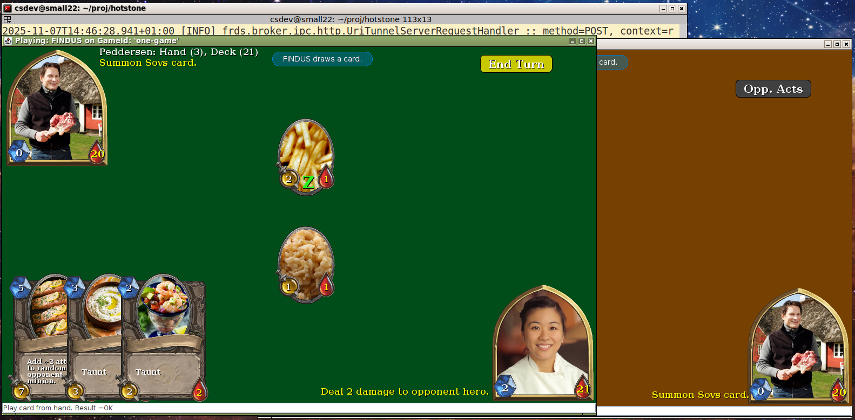
Final HotStone System
Notes:
Meta: Demo ‘gradle server –Pvariant=semi –Pprotocol=chatty’ + ‘gradle clientSWEA –Pwho=findus’ in project hotstone, branch ‘demo-lecture-broker-e25’

Slide 8
Broker I Exercise

Slide 9
Exercises
Broker 1.1
  Develop much of Game’s methods
    All those that handle simple values / no object references
Broker 1.2
  Develop Card and Hero methods (are all simple values)
Broker 1.3
  Make a real manual integration test case using a real HotStoneGameServer – involving a client and a server

Slide 10
Limitations
... To lower your effort ...

Slide 11
You will only...
... Handle a single game on the server
  Only one GameServant object
    Thus its object id is irrelevant and no need to keep a datastructure of multiple servant objects
    Just like the TeleMed system
  Known as the Singleton design pattern
    One, globally, accessible object, only one exists…
    [Some consider this an anti-pattern, but…]

Slide 12
Broker 1.1
Pass by Value Game methods

Slide 13
Pass by Value Methods
Broker 1.1: Develop all pass by value methods of Game

Slide 14
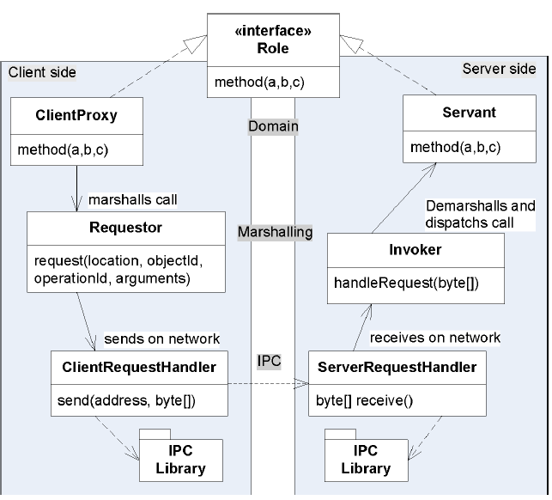
What to implement?
Broker roles
  Most are reused!
Use the JSON
marshalling (Gson)
Use the HTTP IPC
Use Doubles/Your Game
Missing are
  ClientProxies
  Invoker(s)

Slide 15
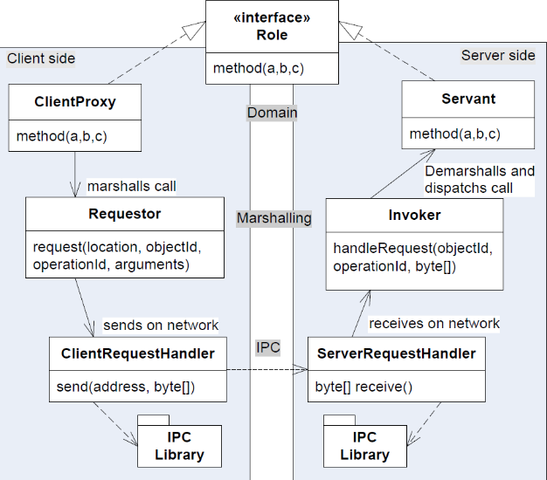
Staring at the Screen
How the h... do you start this exercise?
  I stared at the screen with a very blank expression for 10 minutes
The starting point is to establish the full broker chain of roles...
  (So the template code provides it for
  Game, make your own for Card and
  Hero.)
  hotstone.broker.TestGameBroker

Slide 16
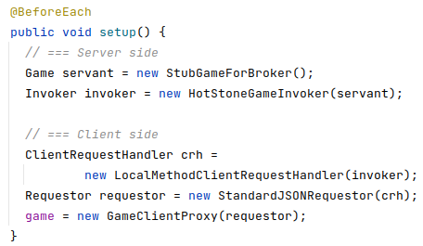
So, First thing to do is...
Make the @BeforeEach method that sets up the chain / dependency inject roles
Example:

Slide 17
Use Doubles ?
Use a Fake Object Game or a special stub game
  Create/reuse a Test fake object for the game
  Or a simple
  AlphaStone ?

Slide 18
Do it without IPC
Take small steps and Keep Focus!
  TDD the ClientProxy + Invoker code first
  Go IPC/distribution next...

Slide 19
Use Doubles
If you develop the Broker code using your full HotStone Game as Servant object...
…You may run into big bang integration problems...
  You have a bug, debug for hours in your ClientProxy and Invoker, only to discover the bug is in some weird strategy in the HotStone code base ☹
Counterpoint
  Your current AlphaStone should be pretty ‘battle hardened’…
Notes:
Example bug: Having two ‘French fries’ card in deck, but it was two linked list entries pointing to a single instance! Then you do not have two cards, you have to references to one card. Made MiniDraw choke!

Slide 20
Use Doubles
Broker code is ‘mechanical transport of data’ and thus no real game behavior is important for testing the broker implementation!
  Different from the MiniDraw exercise – there it was important to visually test the UI
Thus use a test double with weird data if you can…
  Turn number = 312
    Broker can transport any value, and by using ‘weird’ values you are certain you talk to a test stub ☺

Slide 21
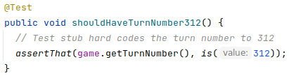
Go depth first...
I advice to TDD the code depth-first
  Breath-first = make all ClientProxy methods first, next all invoker
  Depth-first = make one ClientProxy method and drive all code into existence, that is the Invoker, until the test case pass
That is,
  Step 1: Quickly add a Test

Slide 22
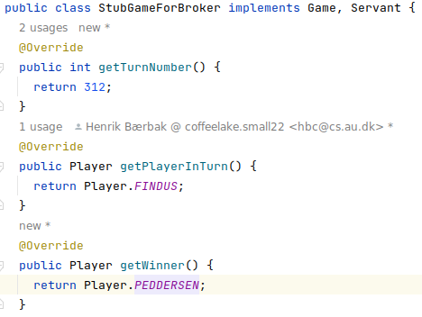
The Test Stub
Step 1: Quickly add a Test
  Purpose: Develop the ClientProxy and the Invoker code
  But the Servant must of course return turn number 312
Make the stub output
easily recognizable output
  If every method returns 0,
  it is difficult to see if you
  call the right one…

Slide 23

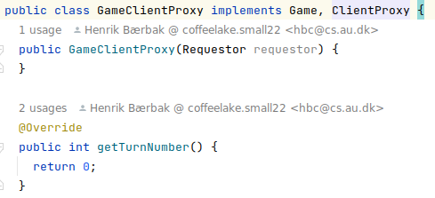
Go depth first...
Step 2: See test fails... Yeah!!!
Step 3: Make a little change...
  Find inspiration in the TeleMed code and make the first method of the first abstraction in the call chain work –
  the GameClientProxy’s getTurnNumber() method...
    Send the method request to the server, using the Requestor’s sendRequestAndAwaitReply() method…
Notes:
Meta: frsproject, hotstone-broker-start, branch e22-broker-initial-working-test-case

Slide 24
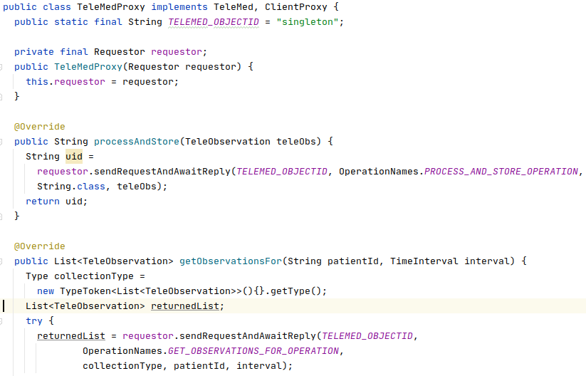
Inspiration
Something inspired by the TeleMedProxy code

Slide 25
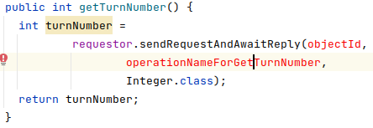
First client proxy method
Inspired by looking at TeleMed code I write my first attempt at a ClientProxy implementation
OK, two issues
  What objectId to use?
  What operation name to use?

Slide 26
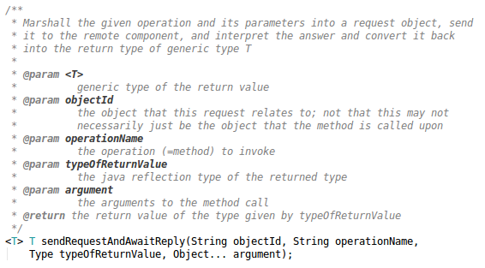
objectId Issue
The objectId???
Answer:
  Single game
  on server
Exercise:
  What is the
  objectId
Notes:
Of course it is ”42” or ”singleton” or ... Ignore it in the invoker as there is only one servant ☺

Slide 27
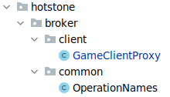
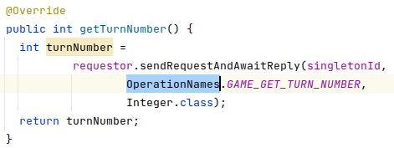
And Operation Name
A mangled string, uniquely identifying the method on both client and server side
  I have provided a class ‘OperationNames’ with all the strings.

Slide 28
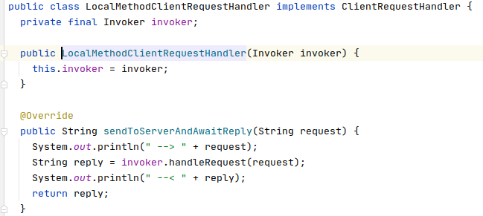
Print Stuff Now, Remove Later!
I print stuff to know ‘where am I’ and I can trace the call chain, inspect JSON request and replies…
Remove System.out again, once all test cases pass!
  Or you when the output is no longer useful. Clean code!
Scaffolding code ☺.
Small steps!

Slide 29
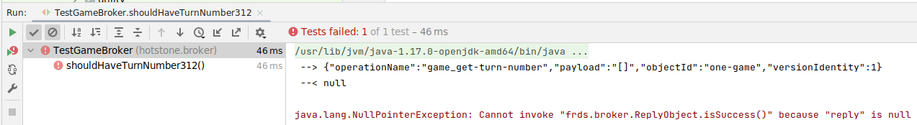
TDD Step 2 or 4?
Step 2: See it fail or Step 4: See it pass???
The printout tells me that I have
  Proxy at step 4: It works!
    The RequestObject looks OK
  Invoker at step 2: No code yet!
Notes:
That is – this test case drives TWO code pieces into existence, and the FIRST code piece is Step 4 (works) while the second is at Step 2 (Fail) and need the Step 3 (add a little code)

Slide 30
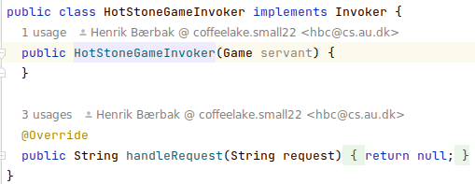
Step 3, part 2
Step 3: Make a little change...
  make the next method of the first abstraction in the call chain work –
  the GameInvoker’s handleRequest’s first switch on method name...

Slide 31
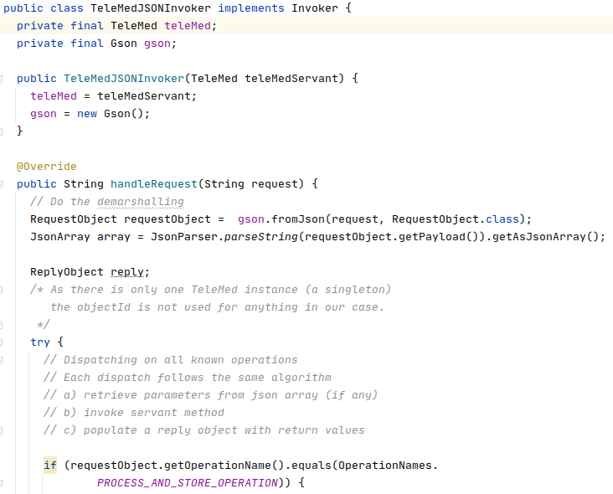
Inspiration
From TeleMed’s
Invoker code
Copy a bit, change
equals(..) to the
right OpName…

Slide 32
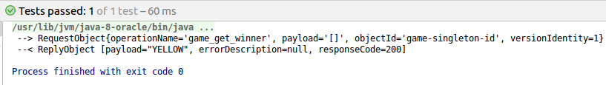
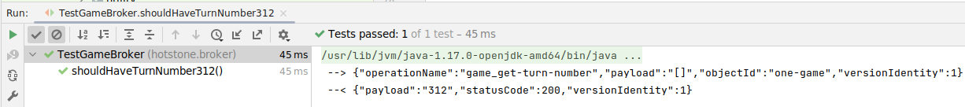
Step 4
A bit of Invoker coding later …
  Test pass
  Output looks OK – proper RequestObject and ReplyObject
Conclusion
  One method of Game is now correctly work through the chain
  All required classes are in place...
  Depth-first! Repeat until all pass-by-value methods in place…

Slide 33
Steal with Pride!
It is a learning process, this one...
  Learn from TeleMed.
  Have the code handy for reference ...

Slide 34
Pass by Value
Broker 1.1: Develop all pass by value methods of Game
Huh? Player???
That is an enum which is actually a class, right?

Slide 35
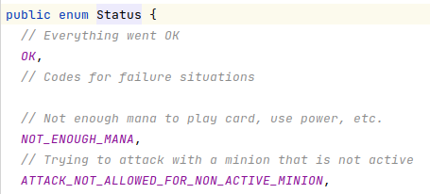


Enums are Values
Enums are in Java implemented as classes but represent values!
Just pass them as values, that is, use Gson to marshall and demarshall
  Gson handles it as you would expect

Slide 36

Observer
A pure client-server architecture cannot implement Observer as outlined previously
  Would involve the server calling the client Not permitted
What then about that aspect of Game?
Exercise:
  In the ClientProxy, what is the
  observer’s responsibility?
  And what implications does that have for the client-server relation?
Notes:
Observer = update the UI, which is a pure client-side responsibility. Thus, it is not something the server should know about! It should be empty for now, will return to this troublesome issue next week.

Slide 37
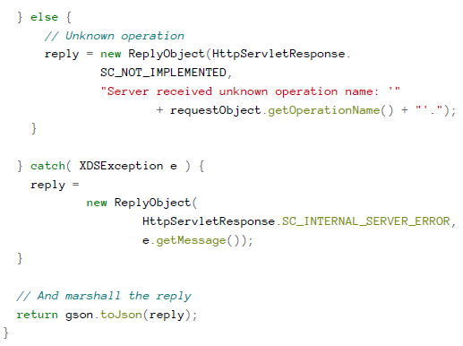
Error Handling
SWEA sticks to the ‘happy path’, so not required …
However, a bit of error handling is nice (optional)
  FRDS.Broker library does support transporting exceptions over the network (sort of).
  Study the TeleMed code ☺ (page 46)
    Handles ‘unknown method’
    Handles ‘exception on the server’
  If the requestor receives a Reply with
  errorcode >= 300, it will
  throw an exception in the client…

Slide 38
Broker 1.2
Hero and Card

Slide 39
Broker Pattern
There is a ‘chain’ for each Role!
Card role
  CardClientProxy
Hero role
  HeroClientProxy
What about Invoker?
  One big invoker?
  Invoker for each role?

Slide 40
Broker 1.2
We will make a stepping stone approach in this exercise…
  Just like in the GameLobby system in the FRDS book, we will make one big invoker (a ‘blob’ invoker).
  That is: there is only one invoker, and it handles method dispatch for Game and Card and Hero
This is “Make horrible sins and clean up later”
  (If you make it clean from the start (= separate invokers for each type) you will run into problems in Broker II exercises ☹)

Slide 41
Hero and Card
These interfaces’ methods all have value type return values
  So, you can develop them! And you are asked to...
Process – similar as for game… Take small steps…
  Make a TestHeroBroker test class
  Make the broker chain as I did in @BeforeEach for Game
  Implement one method depth-first
    HeroClientProxy – then update the associated dispatch in Invoker
  Repeat until done

Slide 42
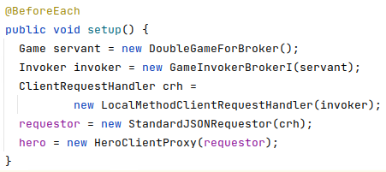
Example Hero
Ala a @BeforeEach like
  The ‘blob’ invoker
  A Hero specific
  ClientProxy

Slide 43


Strings as Value Type
What about String type? It is a Java class, not a primitive type ☹.
Treat String as a value type.
  We need the characters “Siete”, not a memory reference to that string.
Again, Gson will handle it.

Slide 44

Hero and Card
The key obstacle, however, is: What is the objectId?
  Which is the core learning goal of Broker Exercise II, next week
For now Fake it till you make it... Scaffolding !
  Use a ‘fake id’ in the client proxy
  And…

Slide 45
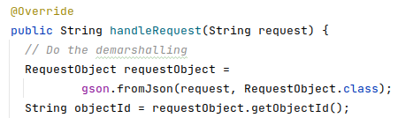


Fake Id in Invoker
Card is not a
Singleton, there
are many of them!
Method encapsulates the lookup. Presently it is fake-it code, but next week can be recoded to proper impl.
One Level of Abstraction – uncle bob

Slide 46
Sidebar Exercise
Why not pass Card as a value type?
  It is just dumb data, right?
  Gson can marshall and demarshall it properly, right?
Argue in favor of pass-by-reference and pass-by-value
In the exercise, you must implement the ClientProxy + Invoker pairs for both Card and Hero
  Which is ‘pass-by-reference’…
Notes:
Two issues: If you pass-by-value then A) changes from remote player X does not show up for remote player Y and B) the methods that takes card references (playCard(who, c )) – the c is a value type that does not make sense on the server side.

Slide 47
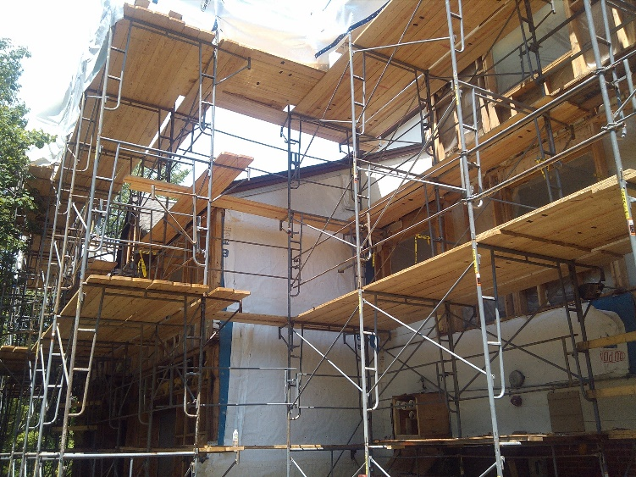
Cost of the FakeIt code
Next week, you will actually have to modify your Invoker quite a bit – split them, replace fake-it lookup…
  Take small steps, sometimes goes via code that needs to be removed again once we get to the
  final stages of the development.
  Scaffolding is common in
  other engineering disciplines ☺

Slide 48
Broker 1.3
The Client and Server programs
Manual integration test

Slide 49
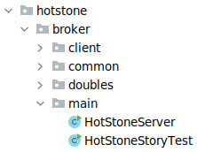
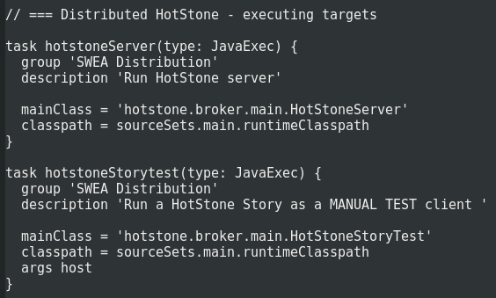
The Main Methods
TDD and Doubles will get all the core code in place.
Still, we need applications to run a distributed system
  HotStoneServer’s main method
  HotStoneClient’s main method
Provided code provides both

Slide 50
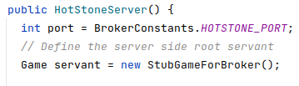
Manual Integration Test
We can build a proper server setup already this week!
Why?
  There is only one Servant game
    Create ‘servant’
    Couple the invoker to it
    Couple a UriTunnelSRH to it
      Listen to HTTP requests from client
And then we are done…
  (Change the servant to your code!)
  (The servant is not complete, but
  will be next week.)

Slide 51
Manual Integration Test
But we cannot build a full-blown client
Why?
  Game only partially done ☹
  The Hero and Card Invokers are
  not coupled to the Game Invoker
  Thus a MiniDraw GUI will fail !
But, we can test the simple
Game methods
A manual integration test
  Call a few simple Game methods over real HTTP network
    And verify that server receives them and returns proper results…

Slide 52
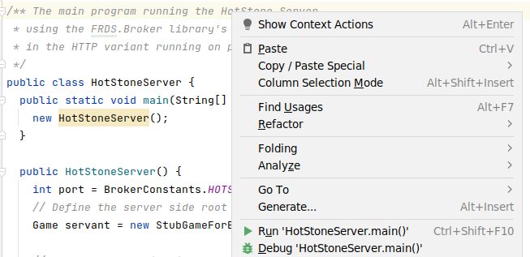
Server Side
Start server using Gradle
Or in IntelliJ

Slide 53
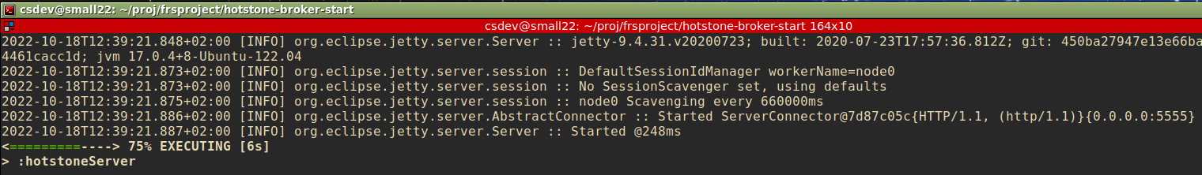
Server Running…
The server uses a Logging framework (SLF4J) to provide server side info – a life saver in case of trouble…
(Controlled by the ‘log4j.properties’ file in the
src/main/resources folder, outside the scope of exercise)

Slide 54
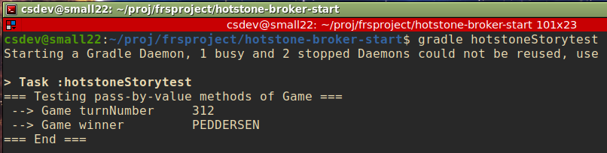
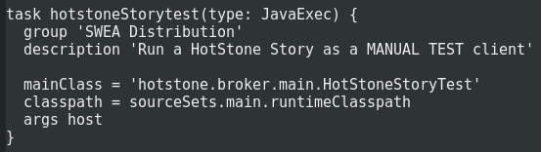
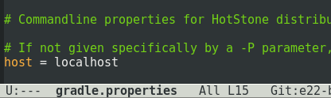
Client Side
Start Client story test using Gradle
This ‘main()’ method needs 1 argument: which server to contact?
Notes:
You can override the host setting using –Phost=(ip address) – IF you code the client to take parameters on from the argument list

Slide 55

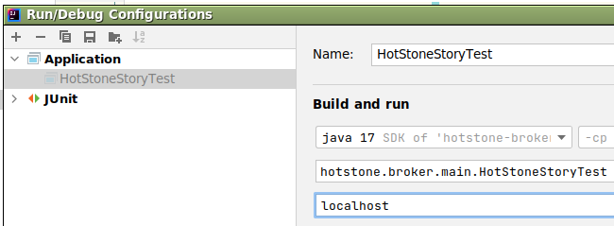
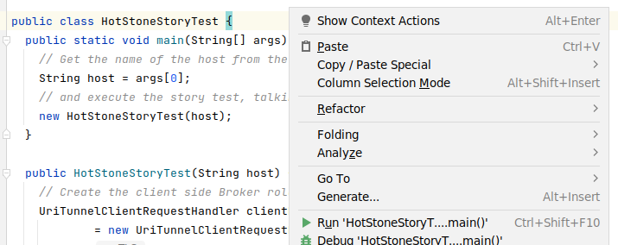
Client Side
From IntelliJ, you also need to give that parameter

Slide 56
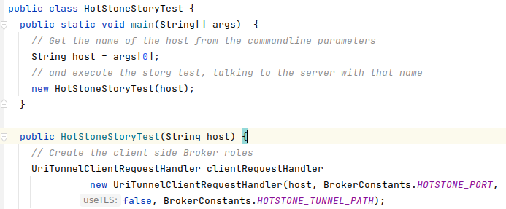
Client Code
Passing host parameter to the main method…

Slide 57
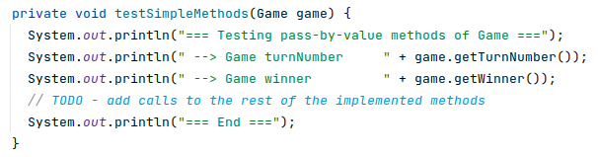
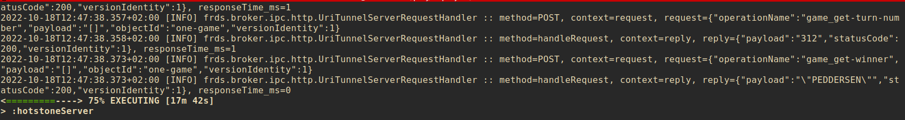
Manual Test method
Let the client just exercise a scenario/remote calls

Slide 58
Summary
Development Patterns for Iteration 9+10
Setup the Broker Chain first
Use Test Doubles for Game and IPC
Print now and remove later
  Print to System.out to trace flow, remove when shit works
Develop each method depth-first
  Make proxy method for method x, see proper output from print, next iteration make invoker code, done…

Slide 59
Conclusion...
Happy Coding!

